Slide 1
Server Components
Overview of server components
Server component rendering
Server component usage scenarios
Mixing server and client components

Slide 2
Section 1: Overview of Server Components
Recap of Next.js rendering
How server components work
Benefits of server components

Slide 3
Recap of Next.js Rendering
By default, Next.js renders components at the server
(Unless you explicitly specify a client component … )
export default function SomeServerComponent() {
return <> … … … </>
}
'use client'
export default function SomeClientComponent() {
return <> … … … </>
}

Slide 4
How Server Components Work (1 of 2)
This is how server components work:
At the browser, the client requests a page (component)
The request is sent to the server
The component code is executed at the server
The pre-rendered HTML is returned to the browser

Slide 5
How Server Components Work (2 of 2)
It's actually a little bit more complicated than that…
At the server:
Next.js generates a combination of HTML and React Server Component (RSC) payload
The RSC payload indicates how client components will be interleaved within the server components
Then at the client:
The HTML is rendered immediately (non-interactive initially)
The RSC payload is unpicked, to create client components

Slide 6
Benefits of Server Components
Direct access to server-side resources
E.g., the server file system, databases, protected REST APIs
Search Engine Optimization (SEO)
Page content is pre-rendered as HTML at the server, so the client receives searchable HTML directly (rather than code)
Caching and faster initial page load time
The pre-rendered HTML is cached at the server and can be shared by multiple clients, which can improve performance

Slide 7
Section 2: Server Component Rendering
Overview
How server rendering works
Static rendering
Client rendering
Aside: Understanding the Router Cache

Slide 8
Overview
There are two server rendering strategies:
Static rendering (rendered at build time) - this is the default
Dynamic rendering (rendered at run time)
Rendering applies on a per-route-segment basis
i.e., per route (path) in your app
Let's see how it works…
8

Slide 9
How Server Rendering Works
By default, server components are rendered statically
i.e., when you build the application
To see this in practice, let's build the demo application demo-server-components now:
After the application has been built, run it as follows:
npm run build
npm run start
9

Slide 10
Static Rendering (1 of 3)
Consider the following example server component:
This component is rendered statically, at build time
See the following slide for how this works in practice…
export default function StaticallyRenderedRouteSegment() {
let ts = new Date()
return (
<>
<h1>Statically rendered route segment</h1>
<div>Date: {ts.toDateString()}, time: {ts.toTimeString()}</div>
</>
)
}
/app/static-rendering-demo/page.tsx
10

Slide 11
Static Rendering (2 of 3)
Next.js generates static content in /.next/server/app/
This is called the Full Route Cache, and it resides on the server
It is cached (fixed) until you rebuild the application
There are 2 files of interest…
static-rendering-demo.html
The server component code has already been executed, and this file contains the resultant (fixed) HTML
static-rendering-demo.rsc
Indicates how the HTML will be merged with other chunks
11

Slide 12
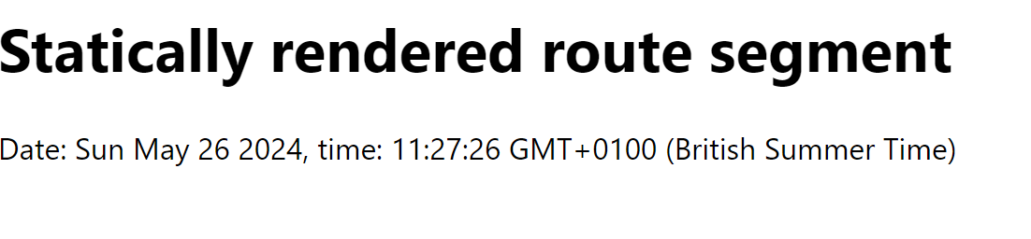
Static Rendering (3 of 3)
This is how the static-rendering-demo route looks
It will always display the same timestamp…
Because it has been statically rendered at build time
🔃
12

Slide 13
Dynamic Rendering (1 of 3)
You can specify that a server component is to be rendered dynamically at run time (e.g., to call a run-time REST API)
This is how you force dynamic rendering for a route:
export const dynamic = 'force-dynamic'
export default function DynamicallyRenderedRouteSegment() {
let ts = new Date()
return (
<>
<h1>Dynamically rendered route segment</h1>
<div>Date: {ts.toDateString()}, time: {ts.toTimeString()}</div>
</>
)
}
/app/dynamic-rendering-demo/page.tsx
13

Slide 14
Dynamic Rendering (2 of 3)
At build time, Next.js doesn't generate static content
Take a look in /.next/server/app/
No pre-rendered files named dynamic-rendering-demo.*
Instead, Next.js creates dynamic JavaScript code
See /.next/server/app/dynamic-rendering-demo/
This code will be run dynamically on the server at run-time, when the client requests the route
14

Slide 15
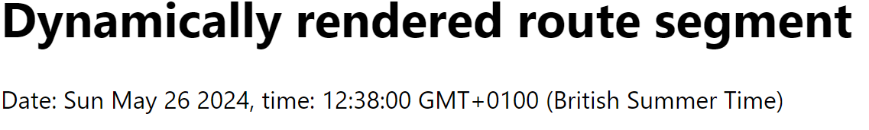
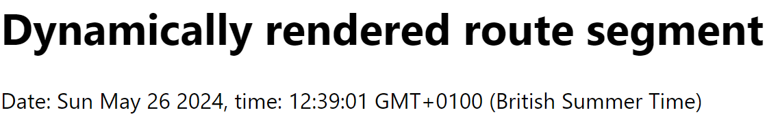
Dynamic Rendering (3 of 3)
This is how the dynamic-rendering-demo route looks
Every time you navigate to this route…
The component is re-rendered dynamically at the server
The generated HTML is returned to the client and displayed
🔃
15

Slide 16
Aside: Understanding the Router Cache
Next.js has something called the Router Cache
Client-side cache, held in browser memory
Stores previously rendered route segments (to minimize lots of requests back to the server)
Duration of route segments in the Router Cache:
Static routes 5 mins, dynamic routes 30 secs
You can force immediate refresh of a route
Call router.refresh()
See dynamic-rendering-with-refresh-demo
16

Slide 17
Section 3: Server Component Usage Scenarios
Overview
Accessing environment info
Invoking protected REST APIs
Accessing the server file system directly
Accessing a database directly

Slide 18
Overview
Server component code is executed at the server (!)
This means we can do some very powerful work directly in our Next.js application (rather than in a separate app):
Access environment info
Invoke protected REST APIs
Access the server file system directly
Access a database directly
Let's see examples of these scenarios
18

Slide 19
Accessing Environment Info (1 of 3)
Imagine you're implementing a Next.js component that needs to utilize a piece of sensitive environment info
E.g., an authentication key, database password, etc.
It's OK for server components to utilize sensitive info
The code runs on the server, hidden from users 👍
It's NOT OK for client components to utilize sensitive info
The code runs in the browser, directly visible to users 😨
19

Slide 20
Accessing Environment Info (2 of 3)
In Next.js, you should put your environment info in a file named /.env.local as shown in this example:
If a property name is prefixed by NEXT_PUBLIC_
The value will be visible in client and server components
If a property name isn't prefixed by NEXT_PUBLIC_
The value will only be visible in server components
The value will be replaced by '' in client components
NEXT_PUBLIC_SALES_TAX_RATE=0.20
API_KEY=jgjhfgj754_564vbn5456456654654bgfh
/.env.local
20

Slide 21
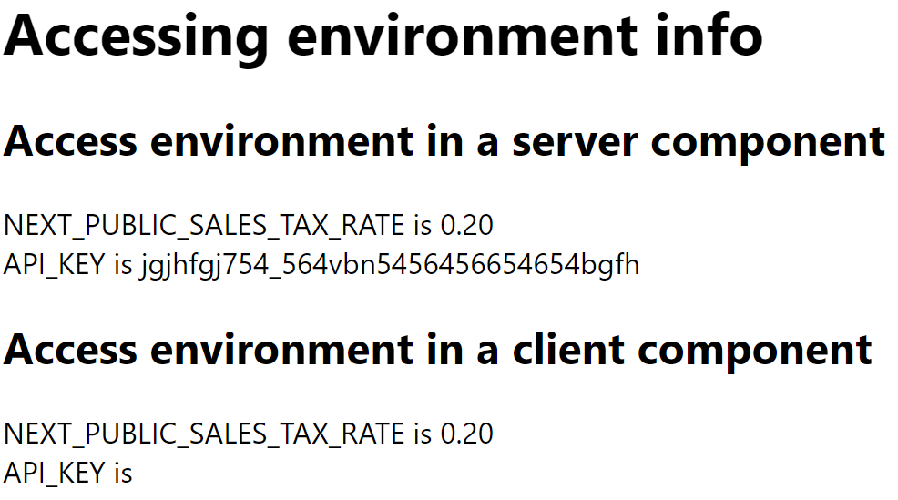
Accessing Environment Info (3 of 3)
To access environment info in a component:
See example in accessing-environment-info route:
process.env.NAME_OF_ENVIRONMENT_INFO_PROPERTY
21

Slide 22
Invoking Protected REST APIs (1 of 2)
Imagine there's a handy REST API you'd like to call, which requires an authentication key from the client
We've implemented such a REST API
See the server-api demo folder
Take a look at the code if you're interested 😊
Run the REST API as follows:
npm install
npm start
22

Slide 23
Invoking Protected REST APIs (2 of 2)
Here's how to invoke the REST API from a server component (see invoking-protected-rest-api route)
Why must it be a server component?
Why must the component be dynamically rendered?
export const dynamic = 'force-dynamic'
export default async function InvokingProtectedRestApi() {
const response = await fetch('http://localhost:8080/server-api/products', {
headers: {
'Auth-Api-Key': process.env.API_KEY || ''
}
})
…
}
/app/invoking-protected-rest-api/page.tsx
❓
❓
23

Slide 24
Accessing the Server File System Directly
A server component can access files and directories on the server file system directly
E.g., see the accessing-server-file-system route:
import fs from 'node:fs'
import parse from 'html-react-parser'
export default function AccessingServerFileSystem() {
const fileName = 'welshAnthem.txt'
const fileContent = fs.readFileSync(fileName, 'utf8')
const fileContentParsedAsHtml = parse(fileContent)
…
}
/app/accessing-server-file-system/page.tsx
24

Slide 25
Accessing a Database Directly (1 of 2)
A server component can access server-side resources
E.g., databases, message queues, cloud resources, etc.
Let's set up a database to illustrate this
Take a look in the db folder
compose.yaml starts a containerized MySQL database
To start the database, start Docker Desktop (if you have it) and run the following command:
docker-compose up
25

Slide 26
Accessing a Database Directly (2 of 2)
The following server component queries the database and displays the results
See the accessing-database route
import mysql, { RowDataPacket } from 'mysql2/promise'
export default async function AccessingDatabase() {
const con = await mysql.createConnection({
host: 'localhost',
user: 'root',
password: process.env.MYSQL_ROOT_PASSWORD
})
const [rows] = await con.query<RowDataPacket[]>(
'SELECT * FROM myschema.employees')
…
}
/app/accessing-database/page.tsx
26

Slide 27
Section 4: Mixing Server and Client Components
Server components can render client components
Passing content from server to client
Client components can't render server components

Slide 28
Server Components can Render Client Components
A server component can render client components
We've seen an example of this already
See the dynamic-rendering-with-refresh-demo route
export default function DynamicallyRenderedRouteSegmentWithRefreshCapability() {
let ts = new Date()
return (
<>
<h1>Dynamically rendered route segment, with refresh capability</h1>
<div>Date: {ts.toDateString()}, time: {ts.toTimeString()}</div>
<RefreshRouteNow />
</>
)
}
/app/dynamic-rendering-with-refresh-demo/page.tsx
28

Slide 29
Passing Content from Server to Client (1 of 3)
You can pass content from a server to a client component
See passing-content-from-server-to-client route
export default function MyServerComponent() {
const filename = 'welshAnthem.txt'
const fileContent = fs.readFileSync(filename, 'utf8')
const fileReadTimestamp = new Date().toTimeString()
return (
<>
<h1>Passing content from a server component to a client component</h1>
<SearchablePanel text={fileContent}>
<hr/>
<small><b>{filename}</b>, read {fileReadTimestamp}</small>
</SearchablePanel>
</>
)
}
/app/passing-content-from-server-to-client/page.tsx
29

Slide 30
Passing Content from Server to Client (2 of 3)
Here's the client component
See passing-content-from-server-to-client route
'use client'
…
export default function SearchablePanel(
{text, children}: {text: string, children: React.ReactNode}
) {
…
return (
<>
<div>{currentContent}</div>
<input type='text' … />
{children}
</>
)
}
30
/app/passing-content-from-server-to-client/searchablePanel.tsx

Slide 31

Passing Content from Server to Client (3 of 3)
Here's how it looks:
31

Slide 32
Client Components can't Render Server Components
Note that a client component cannot render a server component directly
For example:
'use client'
export default function SomeClientComponent() {
return (
<>
<SomeServerComponent />
</>
)
}
😨 NOT ALLOWED!!!
32

Slide 33
Summary
Overview of server components
Server component rendering
Server component usage scenarios
Mixing server and client components

